Slide 1
A social humanistic approach to health:
an integral part of ourselves
possibilities of action
feeling of well-being

Slide 2
Some features on gender and health within a Norwegian context
Norwegian women live longer than Norwegian men, but are more frequent ill.
More men tend to die of accidents and suicide than women.
The health system faces challenges in providing good services to for women of immigrant backgrounds, lesbian women and gay men, disabled women, single mothers (and fathers), and older women.

Slide 3
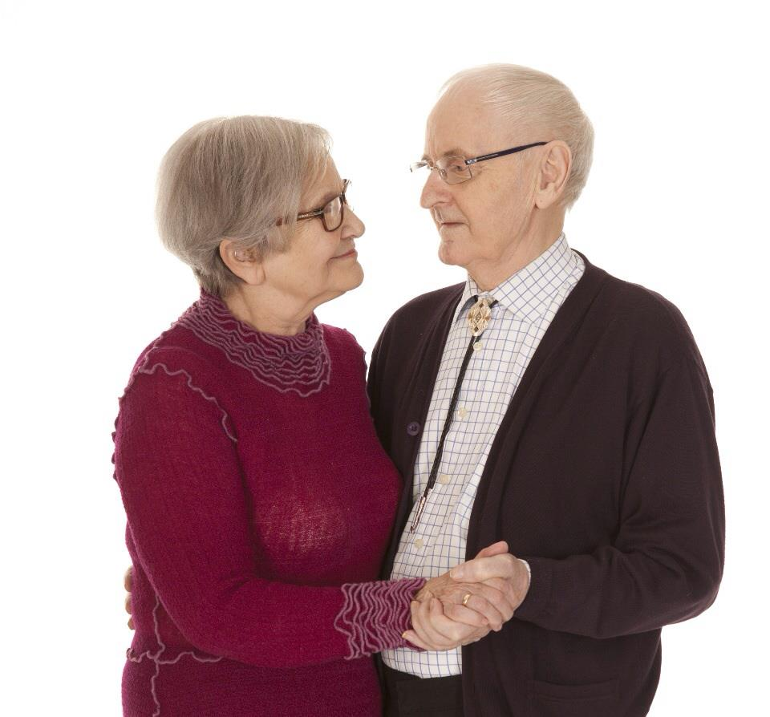
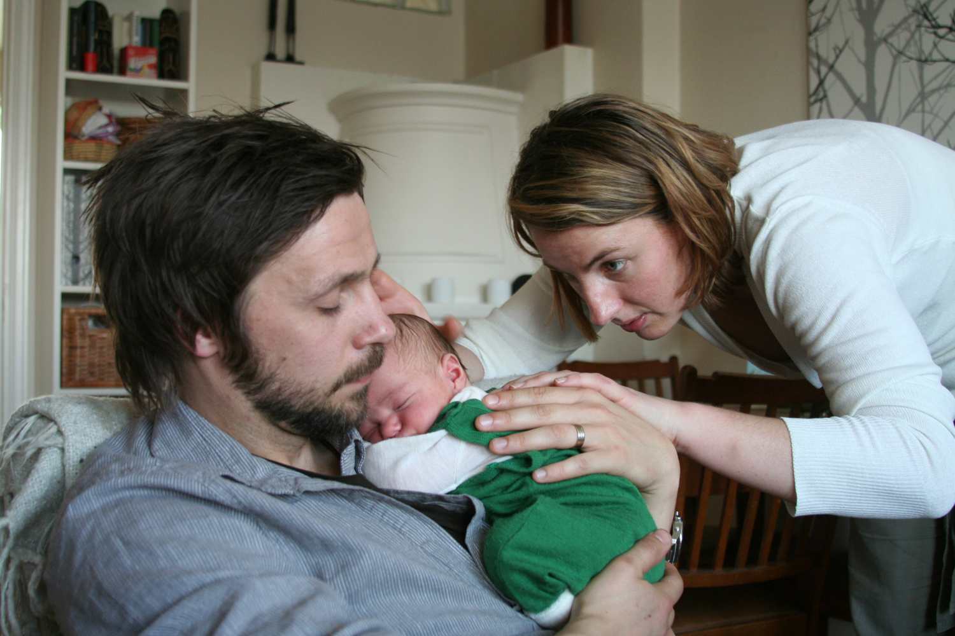
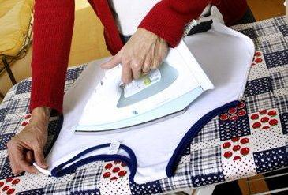
Gender equality, health and well-being

Slide 4
Gender Equality and Quality of life in a Norwegian Context
Symmetric gender relations at work significant influence on health and well-being
Gender equality in domestic work provides
for strong sense of health and well-being
Profound participation in child care – also after divorce - improves mens quality of life

Slide 5
Using qualitative methods to sensitize
and contextualize current models and
perspectives on GEQ
Focus Group Interviews including daily life questions to explore
attitudes, practices and gender power relations within education, work and family

